Slide 1
Steganography of Reversible Data Hiding
Producer: Chia-Chen Lin
Speaker: Paul
2013/06/26

Slide 2
Outline
Introduction
Histogram shifting vs. reversible data hiding
  Three solutions
Conclusions

Slide 3
Introduction
Technical Steganography
  Types
    Loss
    Lossless (reversible)
  General Criteria
    Image quality
    Payload
    Reversibility ←lossless steganography
    reversible data hiding

Slide 4
Histogram shifting vs. reversible data hiding
Zhicheng Ni, Yun-Qing Shi, Nirwan Ansari, and Wei Su, “Reversible data hiding,” IEEE Transactions on Circuits and Systems for Video Technology, Vol. 16, No. 3, 2006, pp. 354-362.

Slide 5
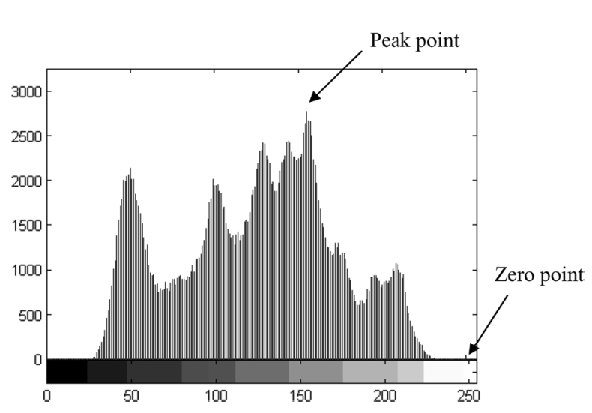
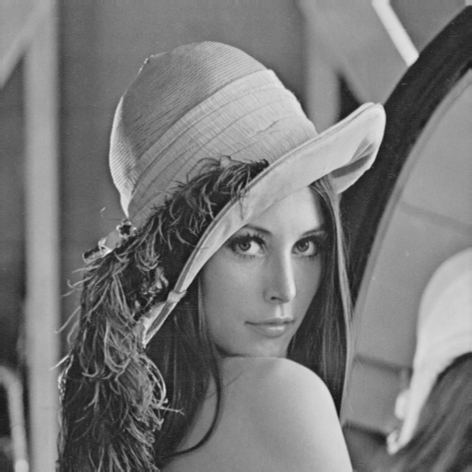
Ni et al.’s proposed method (1/7)
Step 1: Generate an image histogram
(P)
Histogram
(Z)
Original gray-scale image
Histogram of Lena image
Source: Zhicheng Ni, Yun-Qing Shi, Nirwan Ansari, and Wei Su, “Reversible Data Hiding”,
IEEE TRANSACTIONS ON CIRCUITS AND SYSTEMS FOR VIDEO TECHNOLOGY(16:3), 2006.

Slide 6
Ni et al.’s proposed method (2/7)
Step 2: To shift the pixels of histogram
  If P>Z → To shift the range of the histogram , [Z+1, P-1],
  to the left-hand side by 1 unit.
  If P<Z → To shift the range of the histogram , [P+1, Z-1],
  to the right-hand side by 1 unit.
-------------------------------------------------------------------------------------
Step 3: To hide the secret data by pixels P
  If P>Z → To be embedded bit is “1”, the pixel value is changed to P-1.
  If the bit is ”0”, the pixel value remains.
  If P<Z → To be embedded bit is “1”, the pixel value is changed to P+1.
  If the bit is ”0”, the pixel value remains.

Slide 7
Ni et al.’s proposed method (3/7)
2 | 5 | 3 | 1 | 1
4 | 2 | 5 | 1 | 1
2 | 3 | 4 | 4 | 1
3 | 3 | 1 | 2 | 5
3 | 3 | 3 | 3 | 2
Original image
Peak point
Zero point
P=3, Z=6 and P<Z shift to right-hand
2 | 6 | 3 | 1 | 1
5 | 2 | 6 | 1 | 1
2 | 3 | 5 | 5 | 1
3 | 3 | 1 | 2 | 6
3 | 3 | 3 | 3 | 2
[3+1,6-1]
4 → 5
5 → 6

Slide 8
Ni et al.’s proposed method (4/7)
2 | 6 | 3 | 1 | 1
5 | 2 | 6 | 1 | 1
2 | 3 | 5 | 5 | 1
3 | 3 | 1 | 2 | 6
3 | 3 | 3 | 3 | 2
Secret bits: 1 1 0 0 1 1 0 1
2 | 6 | 4 | 1 | 1
5 | 2 | 6 | 1 | 1
2 | 4 | 5 | 5 | 1
3 | 3 | 1 | 2 | 6
4 | 4 | 3 | 4 | 2
Using P=3,
0 → 3
1 → 4
Stego-image

Slide 9
Ni et al.’s proposed method (5/7)
P=3, Z=6
2 | 6 | 4 | 1 | 1
5 | 2 | 6 | 1 | 1
2 | 4 | 5 | 5 | 1
3 | 3 | 1 | 2 | 6
4 | 4 | 3 | 4 | 2
2 | 6 | 4 | 1 | 1
5 | 2 | 6 | 1 | 1
2 | 4 | 5 | 5 | 1
3 | 3 | 1 | 2 | 6
4 | 4 | 3 | 4 | 2
Extracted secret bits:
1 1 0 0 1 1 0 1
Extract
3 → 0
4 → 1
Stego-image
2 | 5 | 3 | 1 | 1
4 | 2 | 5 | 1 | 1
2 | 3 | 4 | 4 | 1
3 | 3 | 1 | 2 | 5
3 | 3 | 3 | 3 | 2
6 → 5
5 → 4
4 → 3
3 → 3
Recover
Original image

Slide 10
Ni et al.’s proposed method (6/7)
Maximum and minimum points
2 | 5 | 3 | 0 | 0
4 | 2 | 5 | 1 | 6
2 | 3 | 4 | 4 | 7
3 | 3 | 1 | 2 | 5
3 | 3 | 3 | 3 | 2
Original image
maximum point
minimum point

Slide 11
Ni et al.’s proposed method (7/7)
Multiple pairs
Example of 2 pairs.
2 | 5 | 3 | 0 | 0
4 | 2 | 5 | 1 | 6
2 | 3 | 4 | 4 | 7
3 | 3 | 1 | 2 | 5
3 | 3 | 3 | 3 | 2
Original image
Z2
P2
P1
Z1

Slide 12
Summary of Ni et al.’s scheme
  It is simple and efficient.
  The PSNR of the marked image is above 48dB.
  The pure payload is about 5k-80k bits for a 512*512 grayscale image

Slide 13
Questions:
How to increase the pixel number of peak point?
  Difference image
Is there any different way to generate a difference image

Slide 14
Solution :
Chia-Chen Lin, Wei-Liang Tai and Chin-Chen Chang, “Multilevel reversible data hiding based on histogram modification of difference images,” Pattern Recognition, Vol. 41, Issue 12, December, 2008, pp. 3582-3591.

Slide 15
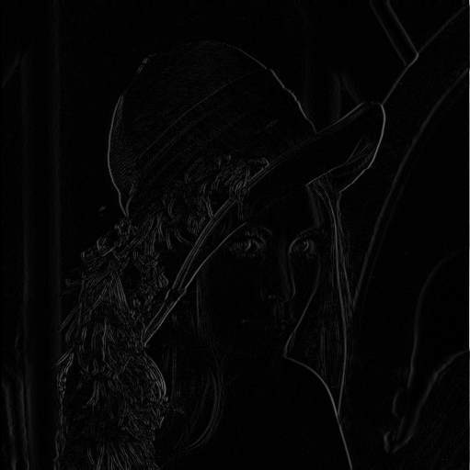
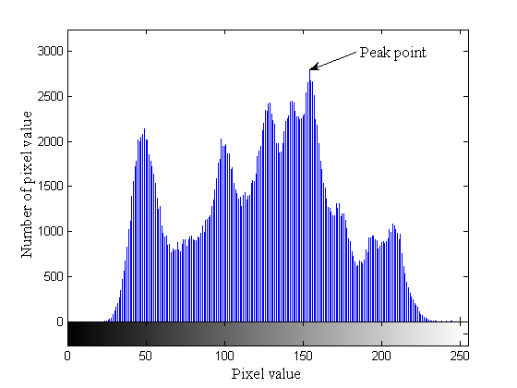
Basic idea

Slide 16

Lin et al.’s proposed method
Hiding Phase
Peak Point
6 | 7 | 3
2 | 1 | 1
1 | 2 | 4
0 | 2 | 1
7 | 8 | 4
3 | 1 | 1
1 | 3 | 5
0 | 3 | 1
7 | 8 | 4
3 | 1 | 1
1 | 3 | 5
0 | 3 | 1
7 | 8 | 4
3 | 1 | 2
1 | 3 | 5
0 | 3 | 1
7 | 8 | 4
3 | 1 | 2
2 | 3 | 5
0 | 3 | 1
162 | 156 | 163 | 160
161 | 159 | 158 | 159
160 | 161 | 159 | 155
158 | 158 | 156 | 157
Difference Image
Original Block
|162 – 156| = 6
Message = “0110”
|161 – 159| = 2
Original Image

Slide 17
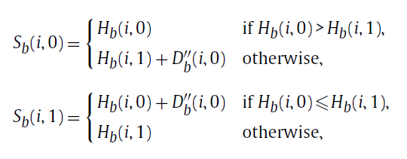
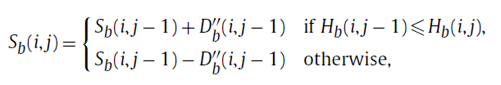
Lin et al.’s proposed method
1.For the first two pixels in each row
2.For any residual pixels

Slide 18
Lin et al.’s proposed method
Hiding phase
162 | 156 | 163 | 160
161 | 159 | 158 | 159
160 | 161 | 159 | 155
158 | 158 | 156 | 157
163 | 156 | 163 | 160
161 | 159 | 158 | 159
160 | 161 | 159 | 155
158 | 158 | 156 | 157
163 | 156 | 163 | 160
162 | 159 | 158 | 159
160 | 161 | 159 | 155
158 | 158 | 156 | 157
163 | 156 | 163 | 160
162 | 159 | 158 | 159
160 | 162 | 159 | 155
158 | 158 | 156 | 157
163 | 156 | 164 | 160
162 | 159 | 158 | 159
160 | 162 | 159 | 155
158 | 158 | 156 | 157
163 | 156 | 164 | 160
162 | 159 | 158 | 159
160 | 162 | 159 | 155
158 | 158 | 155 | 157
163 | 156 | 164 | 160
162 | 159 | 158 | 160
160 | 162 | 159 | 154
158 | 158 | 155 | 156
7 | 8 | 4
3 | 1 | 2
2 | 3 | 5
0 | 3 | 1
Original image
Difference image
Stego-image
156 + 7 = 163
156 + 8 = 164
160 + 4 = 164
159 + 3 = 162

Slide 19
Lin et al.’s proposed method (1/2)
Extracting and reversing phase
7 | 8 | 4
3 | 1 | 1
1 | 3 | 5
0 | 3 | 1
6 | 7 | 3
2 | 1 | 1
1 | 2 | 4
0 | 2 | 1
7 | 8 | 4
3 | 1 | 2
2 | 3 | 5
0 | 3 | 1
163 | 156 | 164 | 160
162 | 159 | 158 | 160
160 | 162 | 159 | 154
158 | 158 | 155 | 156
7 | 8 | 4
3 | 1 | 2
2 | 3 | 5
0 | 3 | 1
162 | 156 | 164 | 160
162 | 159 | 158 | 160
160 | 162 | 159 | 154
158 | 158 | 155 | 156
162 | 156 | 164 | 160
161 | 159 | 158 | 160
160 | 161 | 159 | 154
158 | 158 | 155 | 156
162 | 156 | 163 | 160
161 | 159 | 158 | 160
160 | 161 | 159 | 154
158 | 158 | 155 | 156
162 | 156 | 163 | 160
161 | 159 | 158 | 160
160 | 161 | 159 | 154
158 | 158 | 156 | 156
162 | 156 | 163 | 160
161 | 159 | 158 | 159
160 | 161 | 159 | 155
158 | 158 | 156 | 157
Stego image
Difference image
Original image
Peak Point = 1
Message =
0
1
1
0

Slide 20
Conclusions
Simple is good.
Possible improvements
  Different shifting methods
  Apply different prediction algorithms

Slide 21
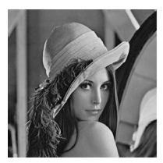
Thanks for your attention !

